Slide 1
Information Technology Fundamentals
DT228/1
Tutorial 9 – IT Disciplines
Thursday 24 November 2016

Slide 2
Disciplines
In the broadest sense, the term information technology is often used to refer to all of computing.
There are many disciplines relating to IT, Computing and technical methodologies. How about ‘Soft Computing’?

Slide 3
Soft Computing
Soft computing is a coalition (consortium, partnership, alliance) of computing methodologies which collectively provide a foundation for the conception, design, construction and utilisation of information/ intelligent systems.
The principal members of soft computing are: fuzzy logic (FL), neurocomputing (NC), evolutionary computing (EC) and probabilistic computing (PC).
Members of soft computing are for the most part complementary and symbiotic rather than competitive.

Slide 4
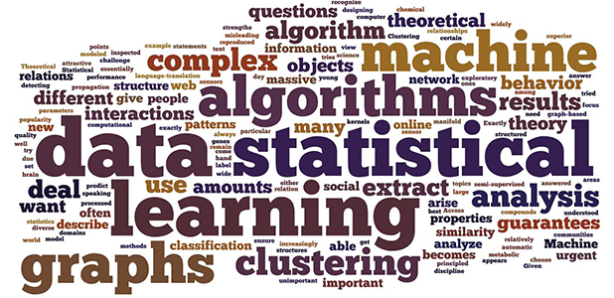
Soft Computing (2)

Slide 5
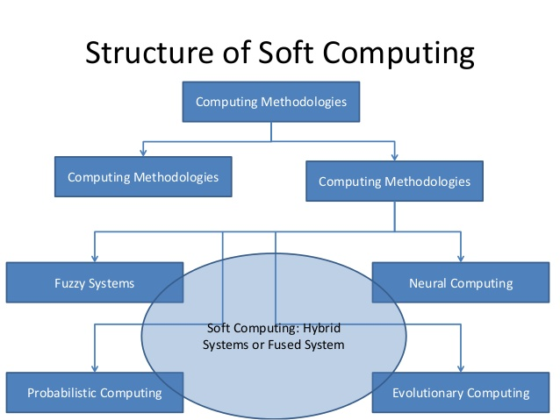
Soft Computing (3)

Slide 6
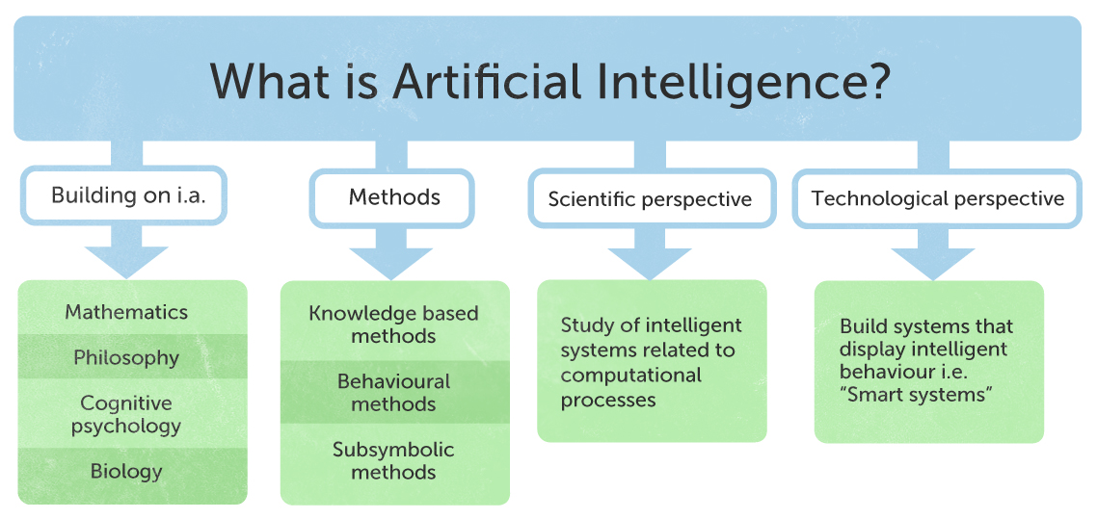
Artificial Intelligence/ Machine Intelligence
Is Artificial Intelligence the same as Machine Intelligence?

Slide 7
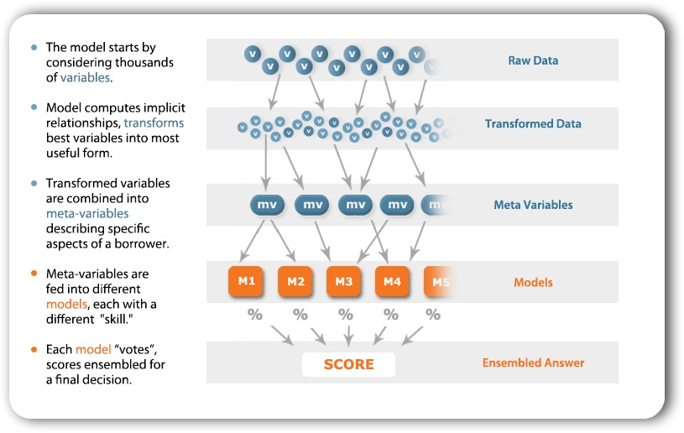
Artificial Intelligence/ Machine Intelligence (2)
Is Artificial Intelligence the same as Machine Intelligence?

Slide 8
TIMELINE OF GROWTH OF MIQ
MIQ
1960
1980
2000
+ perception-based AI
logic-based AI
(symbolic AI)
+ soft computing-based AI
(probabilistic + evolutionary
+ fuzzy + machine learning)

Slide 9
Website of Disciplines
Here is an interesting website on IT Disciplines:
http://www.if4it.com/it-disciplines/

